Slide 1

......
Air monitoring

Slide 2

....
Project definition and design thinking

Slide 3
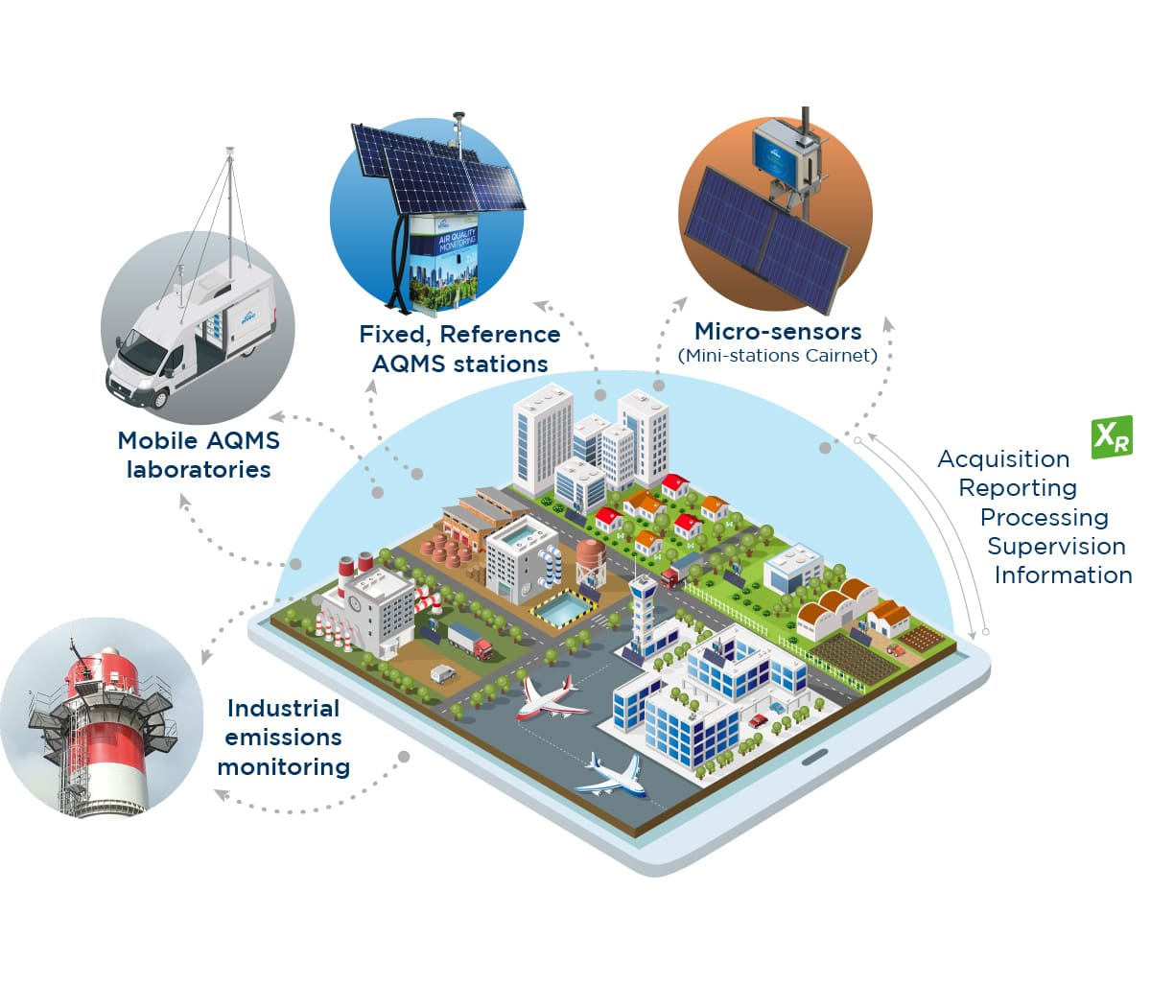
...

Slide 4
PROJECT DEFINITION
An air quality index is an indicator developed by government agencies to communicate to the public how polluted the air currently is or how polluted it is forecast to become. As air pollution levels rise, so does the AQI, along with the associated public health risk.
Ambient air monitoring is the systematic, long-term assessment of pollutant levels by measuring the quantity and types of certain pollutants in the surrounding, outdoor air.

Slide 5
...
The air particulate monitoring based on the BAM principle measures the particle mass density using beta radiation attenuation. The particulates in the ambient air drawn into the air particulate monitor are deposited on a paper-band filter.
Improving air quality, protecting public health, and ensuring compliance with regulations.

Slide 6
TYPES OF AIR MONITORING
Ambient air quality monitoring & Testing.
Indoor air quality monitoring & testing.
Stack emission monitoring & testing.

Slide 7
DESIGN THINKING
Fading air quality in India has moved towards malnutrition, for the past few decades. India remain one of the countries where 1.9 million untimely deaths take place due to worsening ambient air quality.
Revelation to outside air pollutants will enlarge the menace of Arrhythmia, Ischemia, Cardiac Failure and Stroke. Air quality data in Solapur has been analyzed to scrutinize its condition and to recognize its health situation.

Slide 8
.....
The goal of this chapter is to tale on the development of a cost effective air quality monitoring system using wireless sensor network (WSN) and IoT, deployed in polluted areas of Solapur. The air quality in Solapur had been a tight rope walk for its citizens over the past decades.
Solapur Municipal Corporation in alliance with Central Pollution Control Board and State Pollution Control Board has installed air quality monitoring system as an attempt of Swacch Bharat Abhiyan Project.

Slide 9

.....

